Slide 1
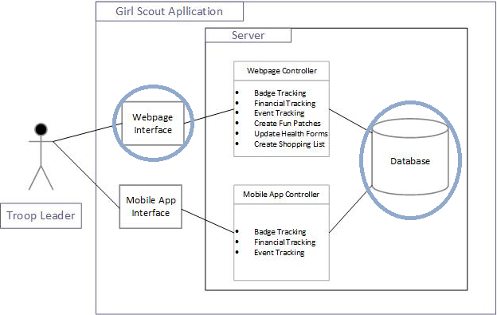
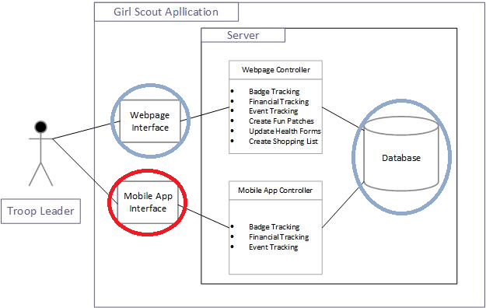
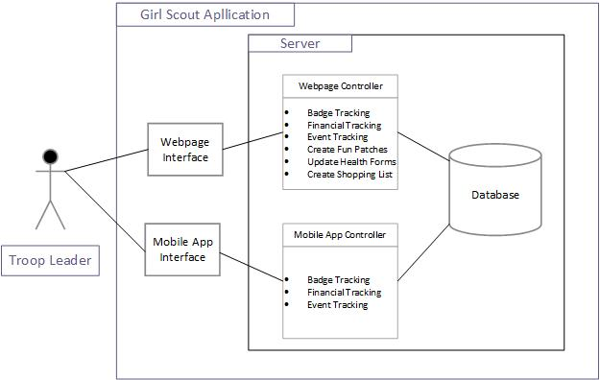
Project Plan
Model View Controller Architecture

Slide 2
Risks
No Server
Lack of mobile development experience

Slide 3
Exit Strategy
Core Components
Database
Website
Risks
Server
Mobile

Slide 4
Quality Assurance

